Slide 1

RUNGTA COLLEGE OF DENTAL SCIENCES & RESEARCH
TITLE OF THE TOPIC –PATIENT AND OPERATORS POSITION
DEPARTMENT OF CONSERVATIVE DENTISTRY AND ENDODONTICS

Slide 2
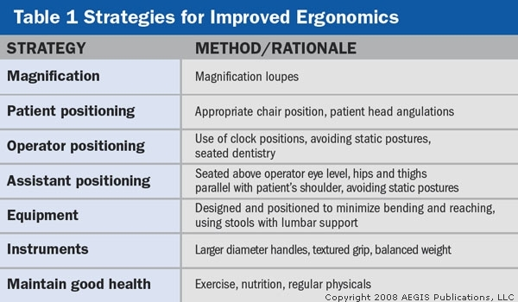
SPECIFIC LEARNING OBJECTIVES

Slide 3
Contents
Introduction
Definition
Work place inervation
Improving ergonomics in a dental set up
Conclusion
References

Slide 4
What is Ergonomics?
Introduction
“Ergo” means work
“Nomos” means natural laws or systems
Ergonomics is the science of work

Slide 5
Introduction
How you position yourself, your patient, how equipment is utilized, how the workplace is designed and how it impacts your health
ERGONOMICS is a way to work smarter, more efficiently with less effort and discomfort to the human body

Slide 6
FOUR-HANDED DENTISTRY
The goal of four-handed dentistry is to allow the dentist and assistant to function as a team in a seated position with maximal efficiency and minimal strain.
Fourhanded dentistry, increases productivity, but also red-uces stress and fatigue on the provider and assistant.
Four-handed dentistry can be used in all of the specialty areas.

Slide 7
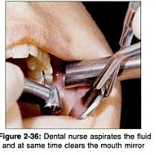
Close support dentistry
There is close cooperation between the dentist and the dental nurse in the actual dental treatment of the patients.
A principal role of the dental nurse is to maintain a clean working field so that the patient is comfortable and the dentist can see the working area.
This involves aspiration of water, retraction of soft tissues, keeping the mirror moisture free and keeping the cavity free of debris.

Slide 8
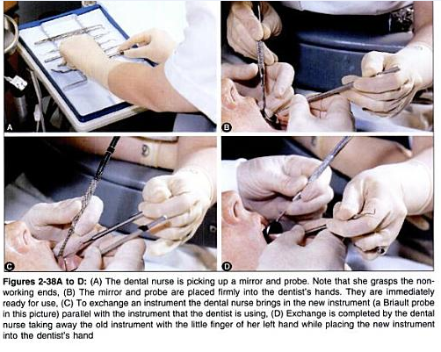

Slide 9
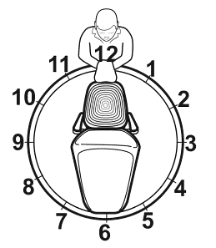
ZONES AND POSITIONS
Position of patient -determined by the procedure to be performed.
Most dental treatment is provided with the patient in the supine position.
Once the patient has been seated, the dentist and the assistant should place themselves in the proper positions
These positions - best understood by relating them to a clock.
Concept - an imaginary circle is placed over the dental chair, with the patient’s head at the center of the circle.
Circle is numbered like a clock with the top of the circle at 12 o'clock

Slide 10
The clock is divided into four zones of operation:
The use of these zones is the key to the efficient implementation of the principles of four-handed dentistry
Static
zone
Assistant's zone
Transfer
zone
Operator's zone

Slide 11
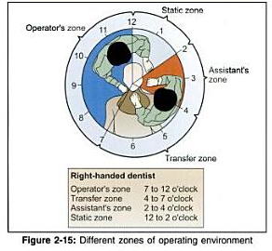

Slide 12
For Right-handed dentists,
For Left-handed dentists,
Seated to right of patient, the operator's zone is between 8 and 11 o'clock, and the assistant's zone is between 2 and 4 o'clock.
seated to right of the patient, the operator's zone is between 1 and 4 o'clock position & assistant's zone between 8 and 10 o'clock.
Treatment site on lingual surfaces of anterior teeth, the dentist (right or left handed) generally uses the 12 o'clock position.
The transfer zone is from 4 to 8 o'clock. Instruments and materials are passed and received in this zone over the chest and at the chin of the patient.

Slide 13
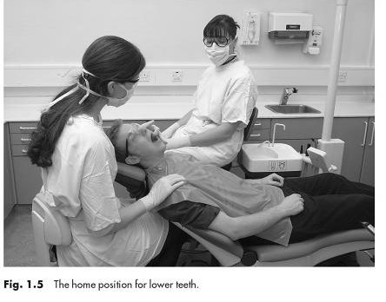
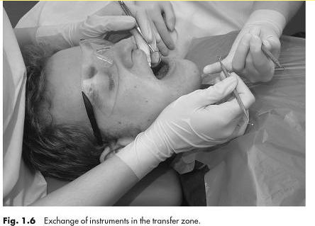
The home position for lower teeth
The exchange of instuments in transfer zone

Slide 14
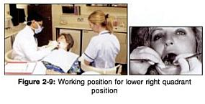
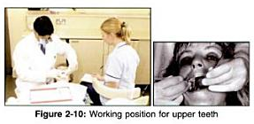
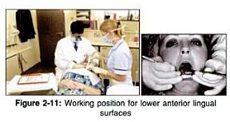

Slide 15
All instruments and materials are located in the assistant's zone.
The static zone, from 11 to 2 o'clock, is a non traffic area where equipment, such as nitrous oxide, can be placed with the top extending into the assistant's zone.

Slide 16
Scheduling
Goal: provide sufficient recovery time to avoid muscular fatigue
Potential strategies
  Increase treatment time for more difficult patients
  Alternate heavy and light calculus patients within a schedule
  Vary procedures within the same appointment
  Shorten patient’s recall interval

Slide 17
TAKE HOME MESSAGE
Serious detrimental physiological changes in the body can result from abnormal postures, including muscle imbalances, muscle necrosis, trigger points, hypomobile joints, nerve compression, and spinal disk herniation or degeneration. These changes often result in pain, injury or MSDs.
Preventing chronic pain in dentistry may require a paradigm shift within the profession regarding clinical work habits, including proper use of ergonomic equipment, frequent short stretch breaks and regular strengthening exercise.
Good ergonomic design of tools, processes and furniture DOES improve personnel comfort, health, morale, productivity and readiness.

Slide 18
QUESTIONS
Advances in operators position ?
What is four handed dentistry ?

Slide 19
References
The Journal of the American Dental Association December 1, 2003vol. 134 no. 12 1604-1612.
The Journal of Calif. Dent assoc. 1996 and 2002
Textbook of operative dentistry : Marzouk
Principles of operative dentistry : A. J. E. Qualtrough, Julian Satterthwaite, Leean Morrow, Paul Brunton
Essentials of Operative Dentistry : I. Anand Sherwood, Ph.D., L. Lakshmi (FRW) Narayanan
www.google.com

Slide 20

Thank You !!!

